Slide 1
Machine vision

Slide 2
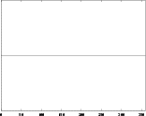
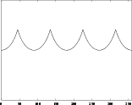
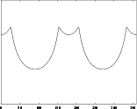
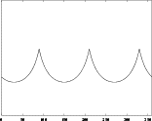
Distance vs. angle signature
Circle
Square
Rectangle
Triangle

Slide 3
Chain codes
Edges must be linked into a representation for a region boundary
  It is called contour
  It can be opened or closed
Chain code
  Basic way to generate a contour
  Using the 8 neighbours of each edge pixel
More complex methods exists

Slide 4
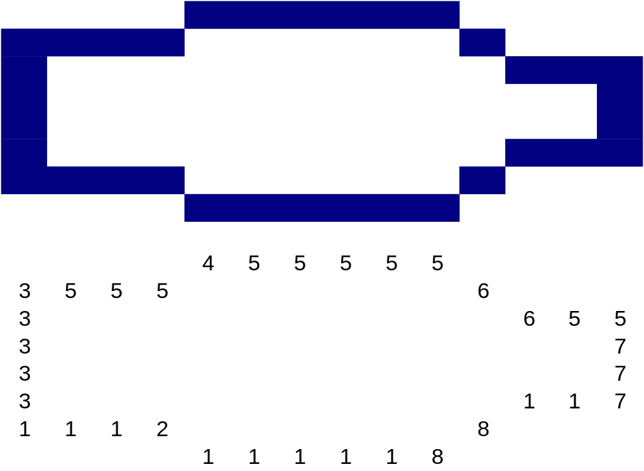
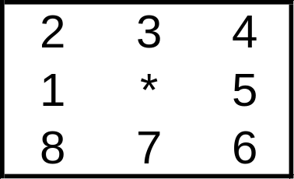
Chain code - example

Slide 5
Hough Transform
Used for isolate curves of a give shape in figures
Very common in detection of regular curves such as lines, circles and ellipses
Uses a voting mechanism
Computationally inefficient for complex models

Slide 6
Hough Transform – Straight line
Consider a straight line y=mx+c
x, y denoted observe values and c, m denotes the parameters
Rewrite the equation to c=y-mx
Plot the equation in a m-c space i.e. x, y are constants
Due to problems with vertical lines use polar form
y
ρ=xcos(θ)+ysin(θ)
ρ
θ
x

Slide 7
Hough Transform Algorithm
Quantize the parameter space appropriately
Assume that each cell in the parameter space is an accumulator Initialize all cells to 0
For each point (x,y) in the image space, increment by 1 each of the accumulators that satisfy the equation
Maxima in the accumulator array correspond to the parameters of model instance

Slide 8


Hough Transform - example
Image after edge filter
Original image

Slide 9


Hough Transform - example
The accumulator array
The accumulator array after contrast stretching

Slide 10
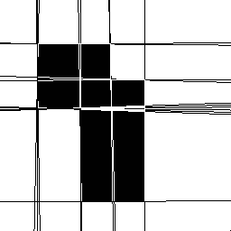
Hough Transform - example

Slide 11
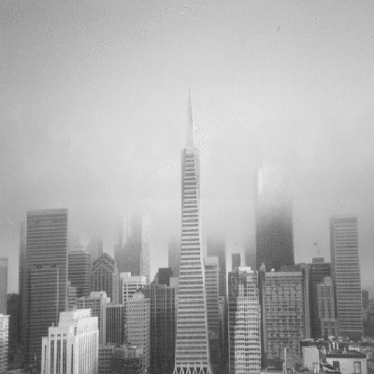

Hough Transform - example

Slide 12
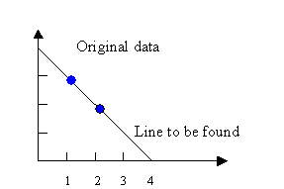
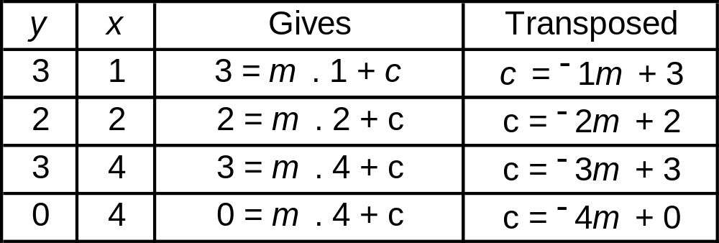
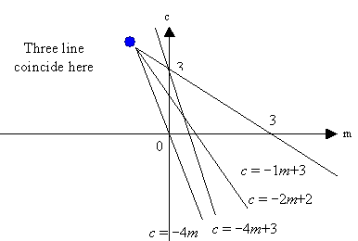
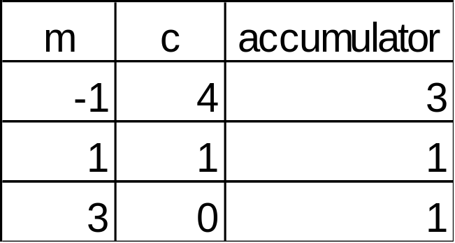
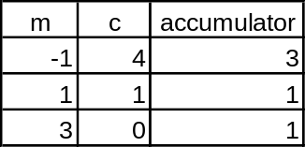
Hough Transform – basic example
Gives
y = −1x + 4

Slide 13
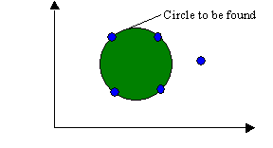
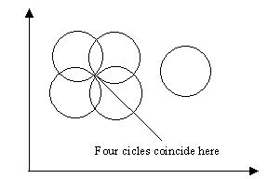
Hough Transform – Circle
(x-a)²+(y-b) ²=r²
Parametric equation for a circle in polar coordinates are
  x = a + r cos θ
  y = b + r sin θ
Solve for the parameters of the circle to obtain the equation
  a = x - r cos θ
  b = y - r sin θ
Eliminating the radius
  b = a tan θ - x tan θ +y

Slide 14
Hough Transform Algorithm
Quantize the parameter space for the parameters a and b
Zero the accumulator array M(a,b)
Compute the gradient magnitude G(x,y) and angle θ(x,y)
For each edge point in G(x,y), increment all points in the accumulator array M(x,y) along the line b = a tan θ - x tan θ +y
Local maxima in the accumulator array correspond to centres of circles in the image.

Slide 15
Template matching
Previous methods tries to determine whether candidates of any kind are present
Is it possible to search for a specific object in the first place?
This can be solved using a temple, which is image of an object to be detected across the current image

Slide 16
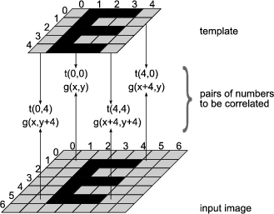
Template matching

Slide 17



Template matching
Template
Input image
Output image
https://docs.adaptive-vision.com/4.7/studio/machine_vision_guide/TemplateMatching.html

Slide 18
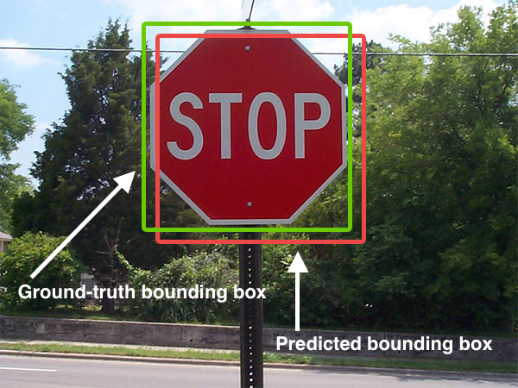
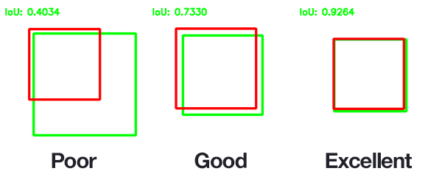

Temple - examples
Wikimedia - common

Slide 19
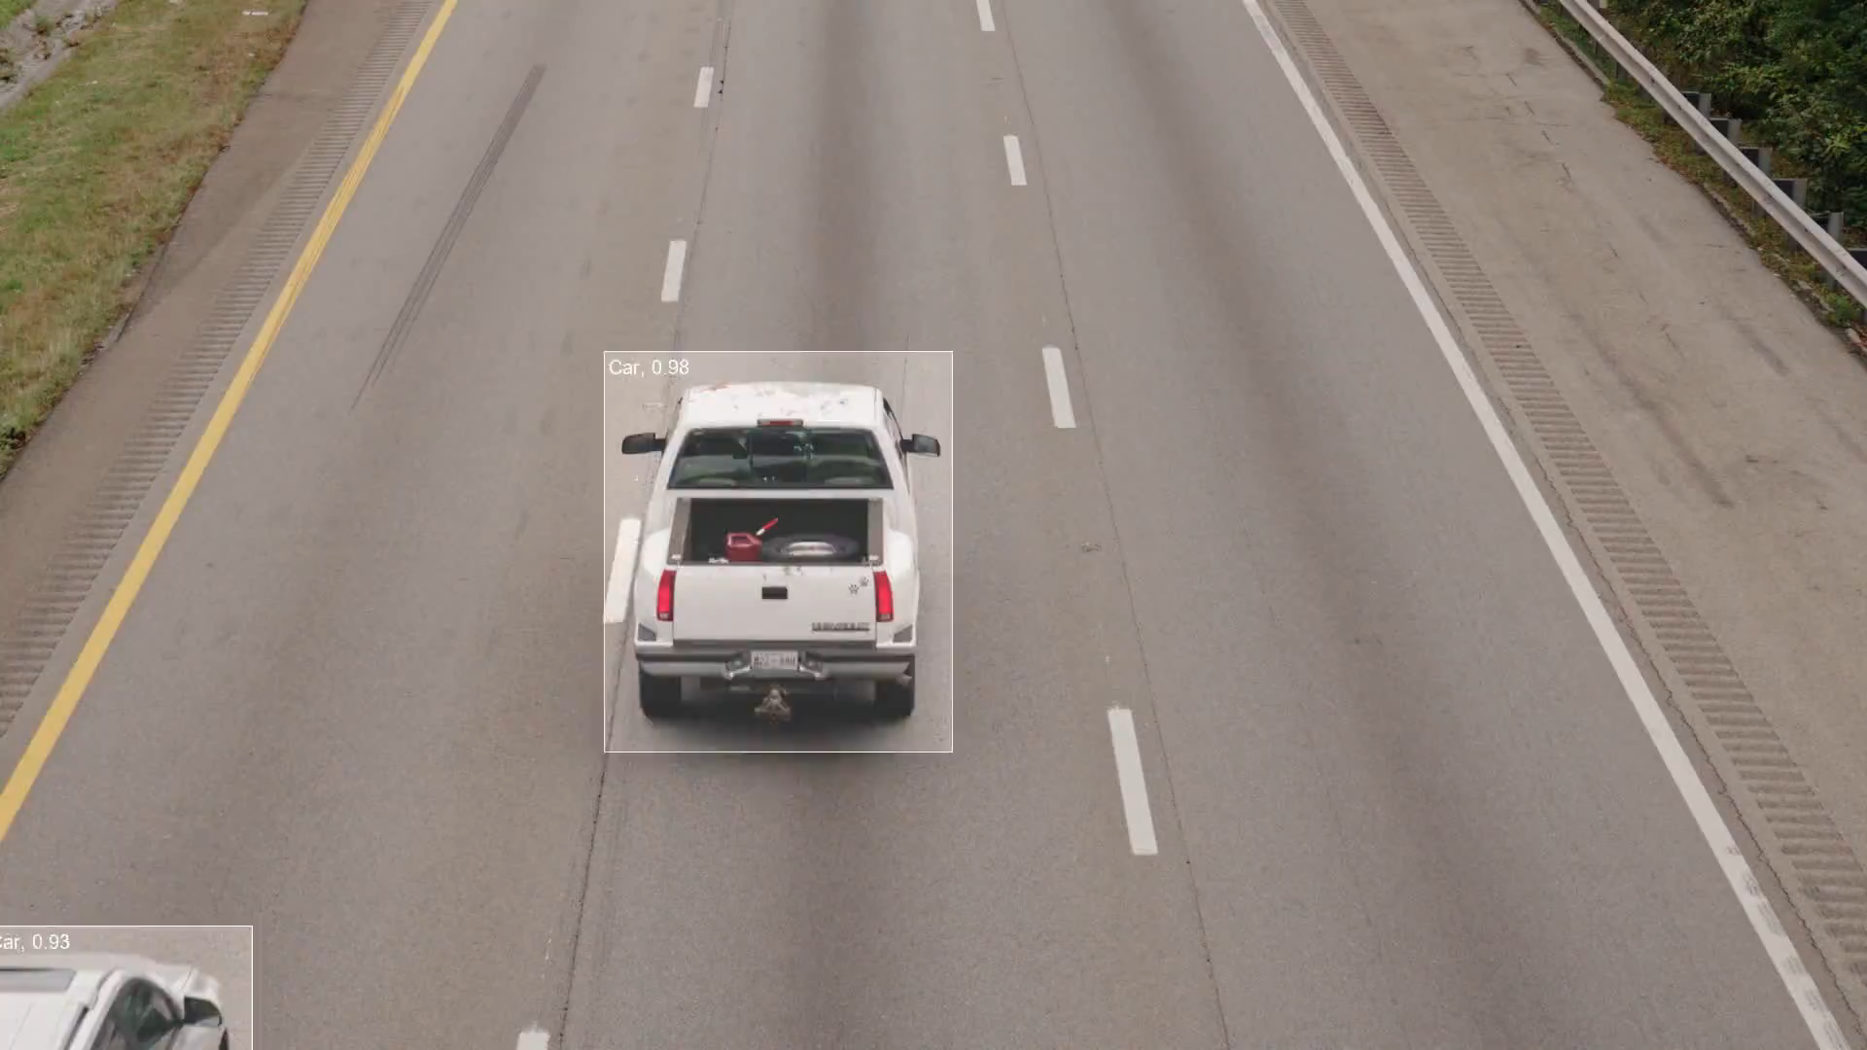

Slide 20
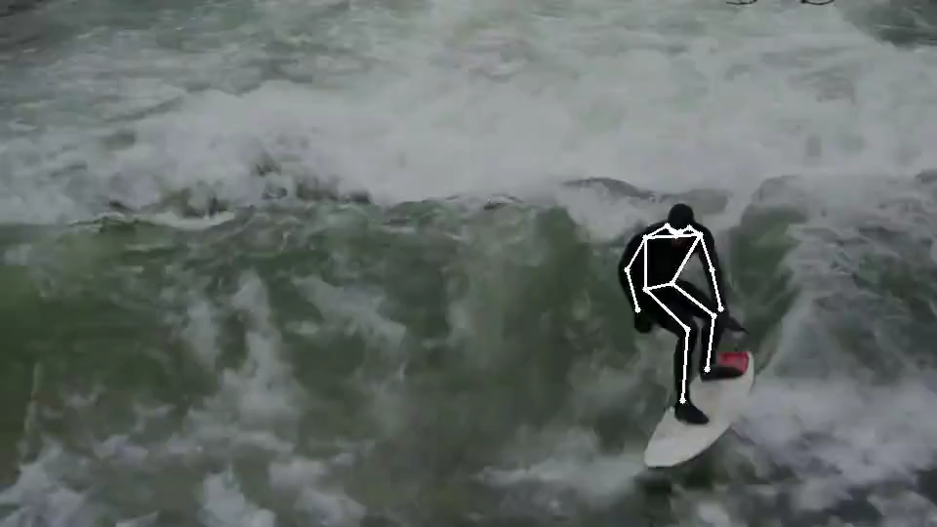

Slide 21
Camera calibration
Essential to obtain accurate measurements of objects
To calibrate a camera, model mapping the 3D points to a 2D image generated from camera, lines, frame grabber (if used) is needed
Commonly used in stereo vision
2 type of optics
  Regular Lenses
  Telecentric lenses

Slide 22
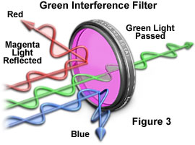
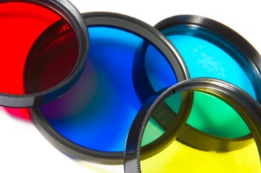
Optical filters
Combined with light source generating specified wavelength
Filters mounts on the camera and are filtering the light to the sensor
Interference filter letting through specific wavelength

Slide 23
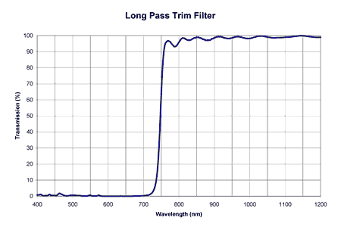
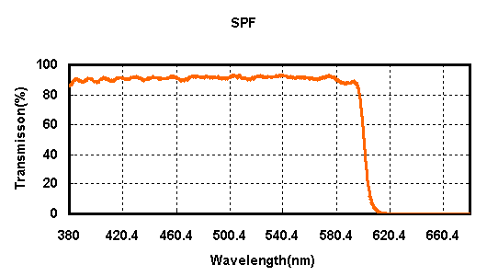
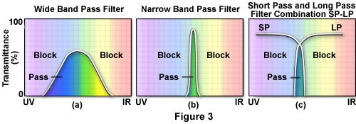
Band pass filters
Long pass filters are blocking short range and letting through long range wave lengths
Short pass filter opposite
Can be combined

Slide 24
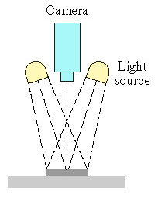
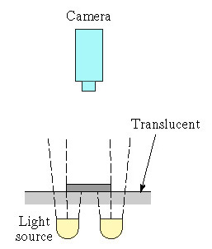
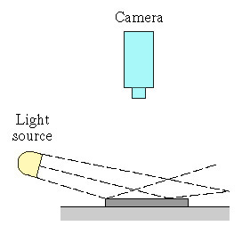
Illumination Techniques
(a) (b) (c)
(a) Front lighting, (b) back lighting, (c) side lighting

Slide 25
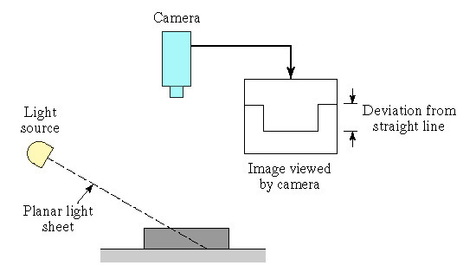
More Illumination Techniques
(d) Structured lighting using a planar sheet of light

Slide 26
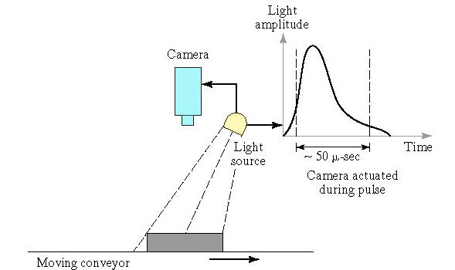
More Illumination Techniques
(e) Strobe lighting

Slide 27
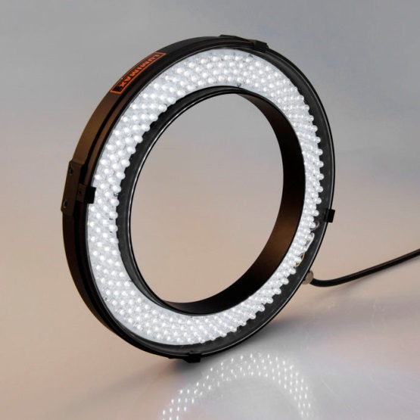

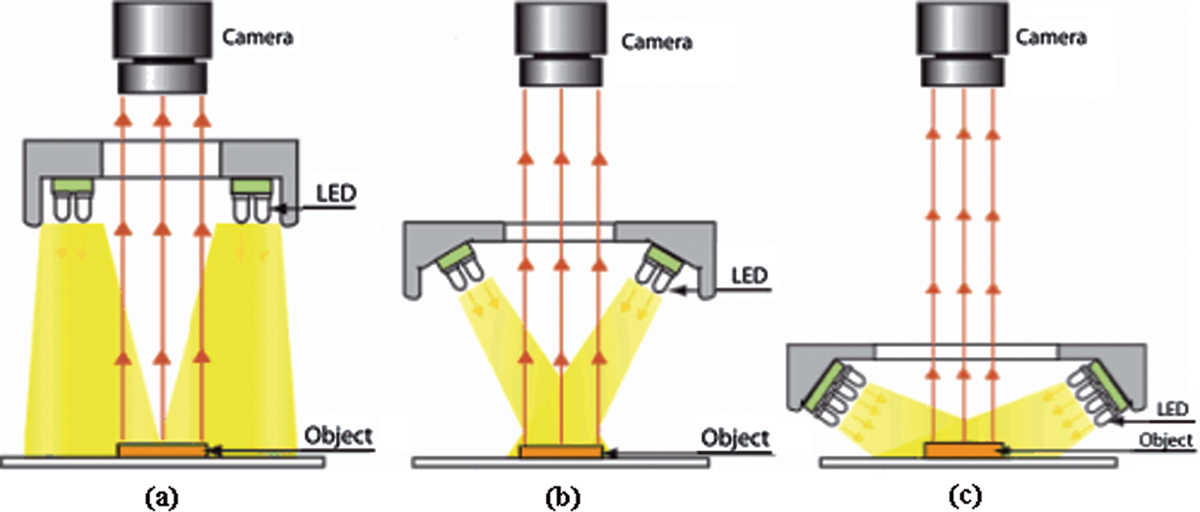
Ring light

Slide 28
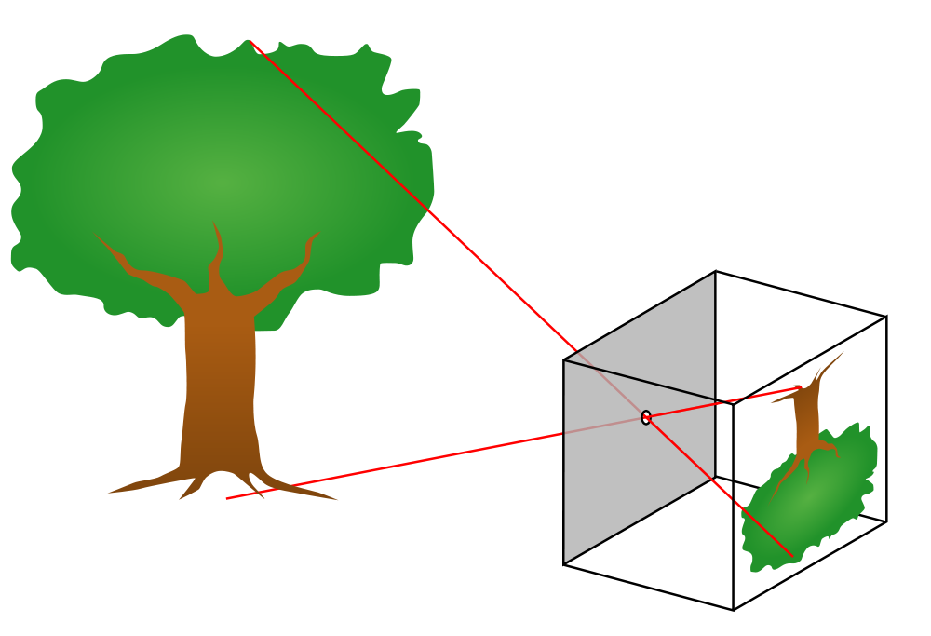
Regulare lenses
Performs a perspective projection of the world into the image
Camera with regulare lens is called pin-hole camera
© GFDL

Slide 29
Drawback with regular lenses
Most lenses exhibit varying magnification for objects at different distances from the lens. This causes several problems for machine vision and other applications:
the apparent size of objects changes with distance from the camera
some features or objects may be hidden by objects that are closer to the lens
the apparent shape of objects varies with distance from the center of the field of view (FOV). Objects appearing close to the edges are viewed from an angle, while objects near the centre of the FOV are viewed frontally (circles near the centre of the FOV become egg-shaped when moved towards the periphery).

Slide 30
Telecentric lenses
Provides an orthographic projection, providing the same magnification at all distances. An object that is too close or too far from the lens may still be out of focus, but the resulting blurry image will be the same size as the correctly-focused image would be

Slide 31
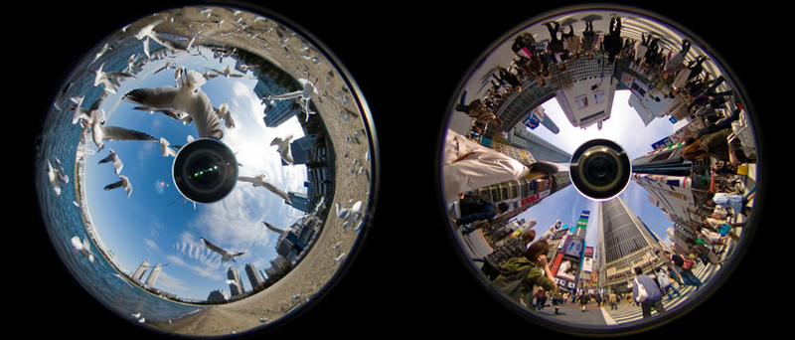
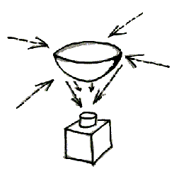
Omnidirectional camera
is a camera with a 360-degree field of view in the horizontal plane, or with a visual field that covers (approximately) the entire sphere.

Slide 32
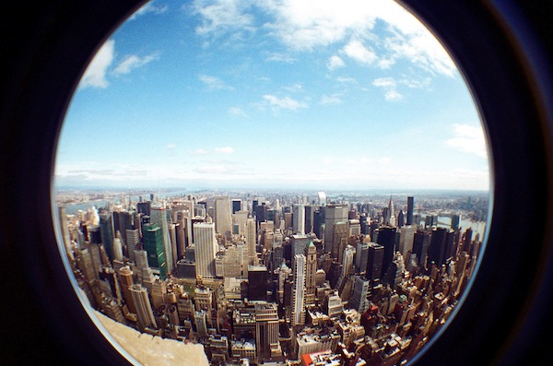
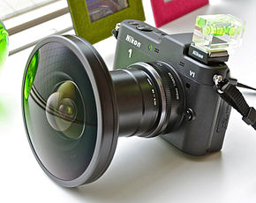
Fisheye camera
A fisheye lens is an ultra wide-angle lens that produces strong visual distortion intended to create a wide panoramic or hemispherical image

Slide 33
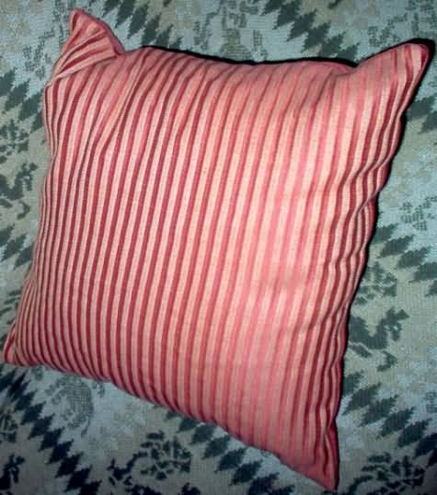
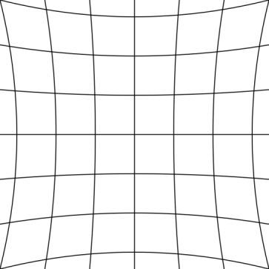

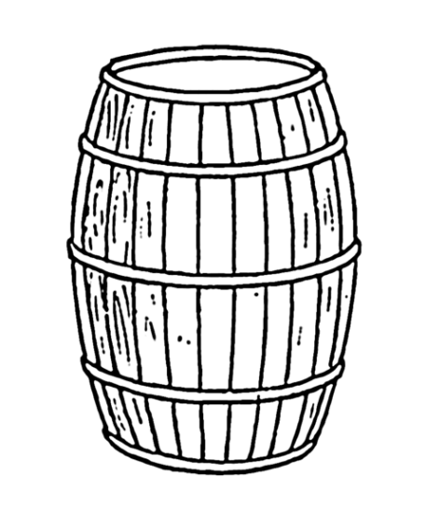
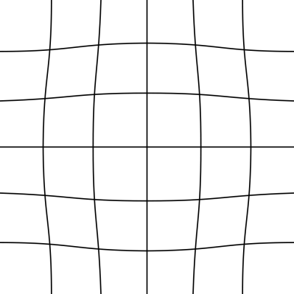

Radiel distortion
Three main types of distortion
  Pincushion
  Barrel
  Mustache

Slide 34
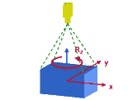
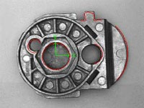
2D images
It delivers reliable information on position, angle, and variation of any part.
Either mounted on the robot or fixed in the robot cell
© GFDL

Slide 35
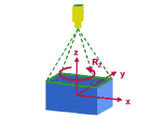
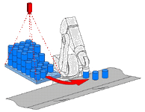
2 ½D vision system
Further development of 2D technology
Determination of a height with 1 camera and 1 position
© GFDL

Slide 36
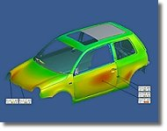
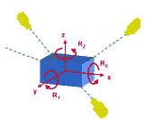
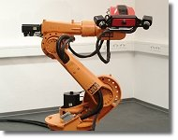
3D Position Recognition Using Photogrammetry
Identifies variations of a given position in all 6 DoF
Applications:
  Geometrical verification
  Assembly process
  Robot guiding
© GFDL

Slide 37

Camera calibration
Referring to the pinhole camera model, a camera matrix is used to denote a projective mapping from World coordinates to Pixel coordinates.

Slide 38
Camera parameters
Intrinsic matrix: containing 5 intrinsic parameters, focal length, image format, and principal point.
Extrinsic parameters: denote the coordinate system transformations from 3D world coordinates to 2D camera coordinates. Equivalently, the extrinsic parameters define the position of the camera center and the camera's heading in world coordinates.

Slide 39

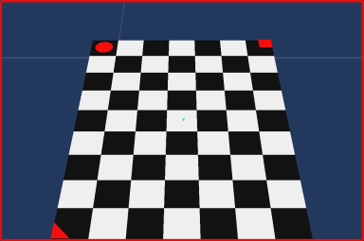
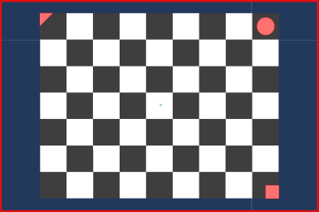






Camera calibration images

Slide 40


Example of excentric results
world-centered view
Extrinsic to show the new 3D positions of the grids with respect to the camera

Slide 41

Camera calibration
Input image
Output image

Slide 42

Calibrated images
Input image
Output image

Slide 43

Bin-picking
https://www.youtube.com/watch?v=QyWv_KW2pXo

Slide 44
Test at spare time
Search for ”camera calibration toolbox for matlab”. Free software. Very good!!

Slide 45

Human stereo vision

Slide 46

Stereo vision

Slide 47

Camera setting
Structure from stereo (Stereo-vision):
  use two cameras with known relative position and orientation

Slide 48

Correspondence Problem
Which patch in the Left image, corresponds to the projection of the same 3D scene point on the Right image?
  Correspondence search could be done by testing the query-patches at all pixel positions in the other image.
  Exhaustive image search can be computationally very expensive

Slide 49


Correspondence Problem
Which patch in the Left image, corresponds to the projection of the same 3D scene point on the Right image?

Slide 50

Correspondence Problem

Slide 51
Work flow
Stereo camera calibration ➔ compute camera relative pose
Epipolarrectification ➔ align images & epipolar lines
Search for correspondences
Output: compute stereo triangulation or disparity map
Consider baseline and image resolution to compute accuracy

Slide 52

Multiple cameras

Slide 53


3D scanning photogrammetry
3D camera setup
Projector
Structure light

Slide 54



3D scanning Photogrammetry

Slide 55


Example of 3D scanning

Slide 56

Example of 3D

